Slide 1
Playwright Test Report Generation & Jenkins CI Integration
Step-by-step Guide with Commands & Configuration

Slide 2
Agenda
- Generate HTML & Allure Reports in Playwright
- Installation & Configuration in Jenkins
- Integrate Playwright with Jenkins Pipeline
- Step-by-step Execution Commands

Slide 3
Understanding Playwright Reporters
Playwright supports multiple reporters:
- List: Default CLI output
- Dot: Minimal console output
- HTML: Interactive visual reports
- JSON: Structured data output
- JUnit: XML output for CI tools
- Allure: Rich and visually detailed report (via plugin)
Configure multiple reporters:
reporter: [['list'], ['html'], ['allure-playwright']]

Slide 4
HTML Report in Playwright
Step-by-Step:
1. npm init playwright@latest
2. playwright.config.js:
reporter: ['html']
3. npx playwright test
4. npx playwright show-report

Slide 5
Overview of Allure Reports
Why use Allure?
- Timeline view of test runs
- Attach screenshots, videos, logs
- Categorized results (passed, failed, skipped)
- Easy CI/CD integration

Slide 6
Allure Report Setup
1. npm i allure-playwright
2. playwright.config.js:
reporter: [['list'], ['allure-playwright']]
3. npx playwright test
4. Generate Report:
npx allure generate ./allure-results --clean -o ./allure-
report
npx allure open ./allure-report

Slide 7
Jenkins Overview
Jenkins is an open-source automation server
Supports CI/CD and integrates with Playwright, Git, Allure
Benefits:
- Dashboards
- Build history
- Plugin-based

Slide 8
Jenkins Installation
Windows:
- Install Java (JDK 11/17)
- Download from jenkins.io
Linux:
- Install OpenJDK
- Add Jenkins repo
- sudo apt install jenkins
- sudo systemctl start jenkins

Slide 9
Create Playwright Project in Jenkins
1. Create Freestyle or Pipeline Job
2. Use Git for source control
3. Build steps:
npm ci
npx playwright install
npx playwright test
npx allure generate
4. Post-build: Publish Allure Report

Slide 10
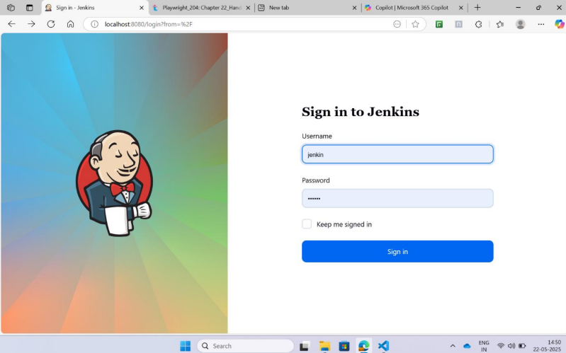
Jenkins Setup & Plugins
1. Login to Jenkins at "localhost:8080“ To begin configuring Jenkins, open your web browser and navigate to http://localhost:8080

Slide 11
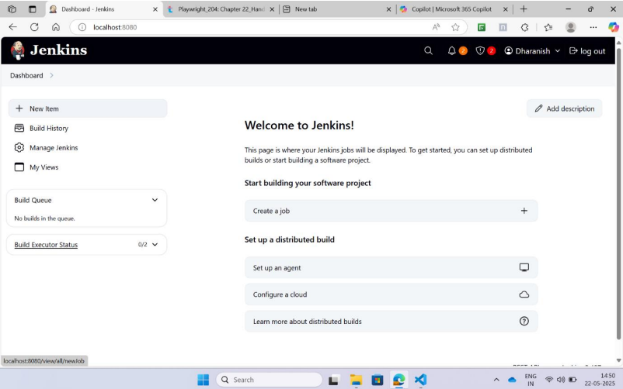
2. . Click on “New Item” and Enter the Project Name From the Jenkins dashboard, click on the “New Item” link on the left-hand side. This will open a page where you can create a new Jenkins job. Enter a descriptive name for your project, such as PlaywrightTestJob, in the text field. This name will be used to identify the job in Jenkins, so choose something meaningful that reflects the purpose of the job.

Slide 12
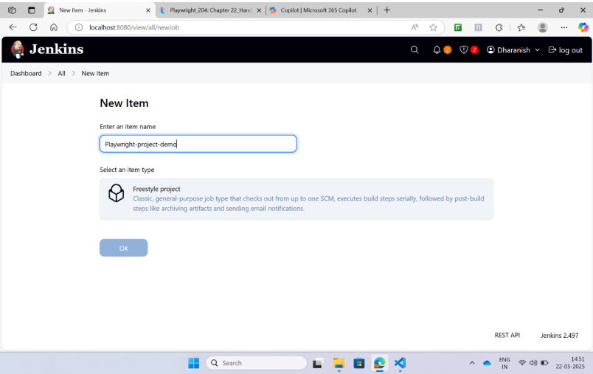
.
3.Choose “Freestyle Project” from the List of Available Options
After entering the project name, select the “Freestyle project” option from the list of available job types. Freestyle projects are flexible and suitable for simple build and test automation tasks. Once selected, click the OK button to proceed to the job configuration page. This is where you’ll define how Jenkins should build and run your Playwright tests.

Slide 13
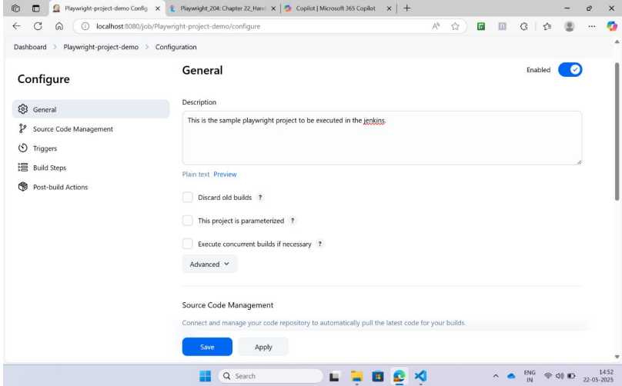
4. Enter Project Details and Project Description
On the configuration page, you’ll see a field labeled “Description”. Here, you can provide a brief summary of what the project does, such as “This Jenkins job runs Playwright tests using the Page Object Model structure.” Adding a description is optional but recommended, especially when working in teams or managing multiple jobs, as it helps others understand the purpose of the job at a glance.

Slide 14
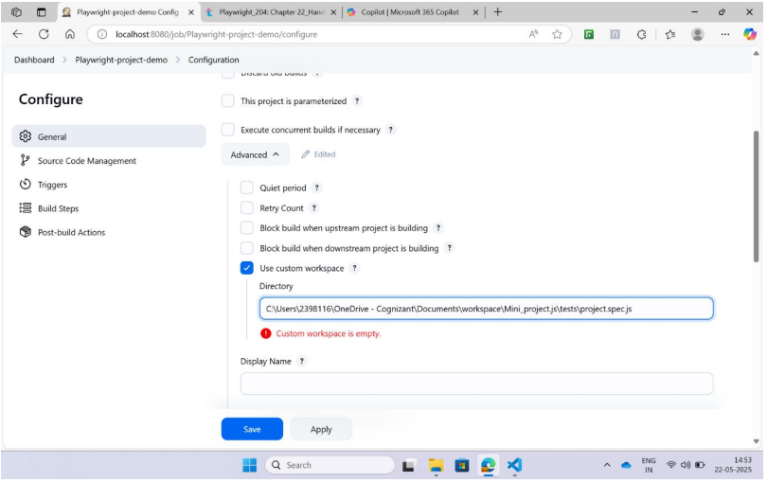
5. Provide Source Code Repository URL (If Source Code is Available in Git)
Scroll down to the “Source Code Management” section and select Git. In the Repository URL field, enter the URL of your Git repository where the Playwright test scripts are stored (e.g., https://github.com/yourname/playwright-tests.git ). If the repository is private, you’ll need to add credentials by clicking the Add button and entering your Git username and password or personal access token. This allows Jenkins to clone the repository during the build process. Click the ‘advanced’ section drop-down and click the ‘use custom workspace’ and give the path of the saved project file in the ‘directory’.

Slide 15
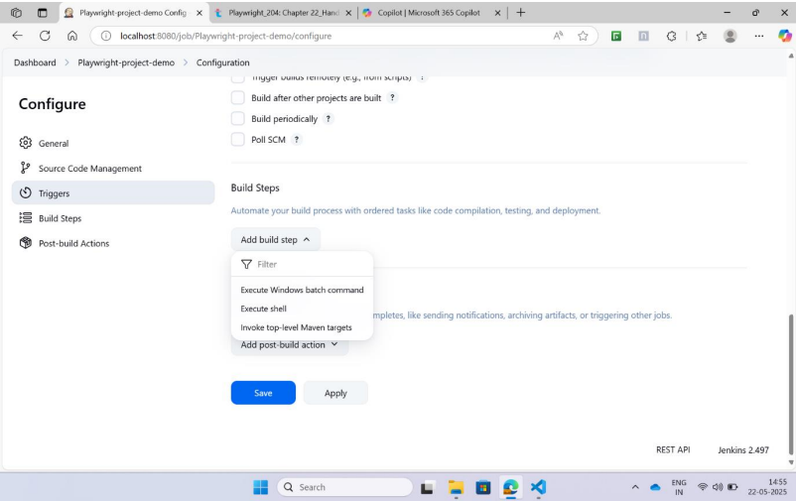
6. Update the Build Job Settings by Providing the Maven Command
Although the instruction mentions Maven, Playwright is a Node.js-based tool and does not use Maven. Instead, you should configure the build step to run shell commands. Scroll to the Build section, click “Add build step”, and choose “Execute shell”. In the command box, enter the following: npm install npx playwright install npx playwright test These commands install the project dependencies, set up Playwright browsers, and execute the test suite

Slide 16
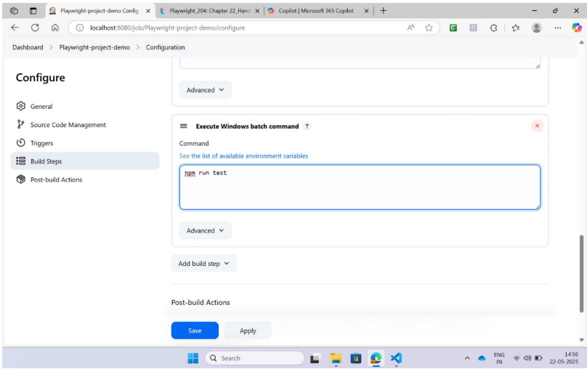
In the ‘Build Steps’ section, select ‘Execute Windows batch command’. In the ‘Build Triggers’ section, select ‘Build after other project are build’ (If necessary). In the ‘Build Environment’ section, select ‘Color ANSI console output’ and type ‘xterm’ in the textfield. In the ‘Build Steps’ section, select ‘Execute Windows batch command’ and type ‘npm run test’ in the textbox

Slide 17
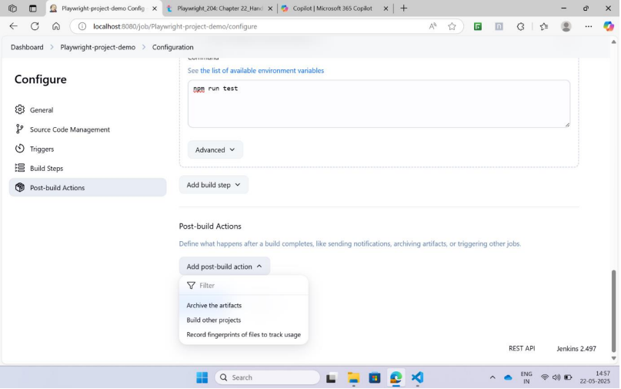
7. Save the Project
Once all configurations are complete, scroll to the bottom of the page and click the “Save” button. This saves your job configuration and returns you to the project dashboard. You can now see your job listed on the Jenkins home screen or under the “All” tab

Slide 18
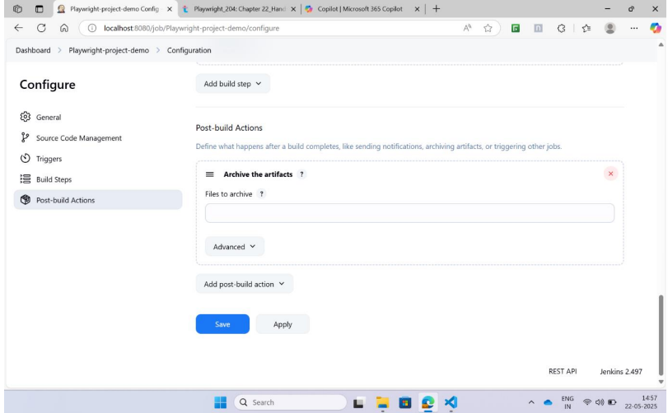
In the ‘Post build actions’ section, select ‘Publish HTML reports’ and click ‘add’ and give the path of the report of playwright file in ‘directory’ and give the title as ‘HTML report’ in the ‘title’ textbox

Slide 19
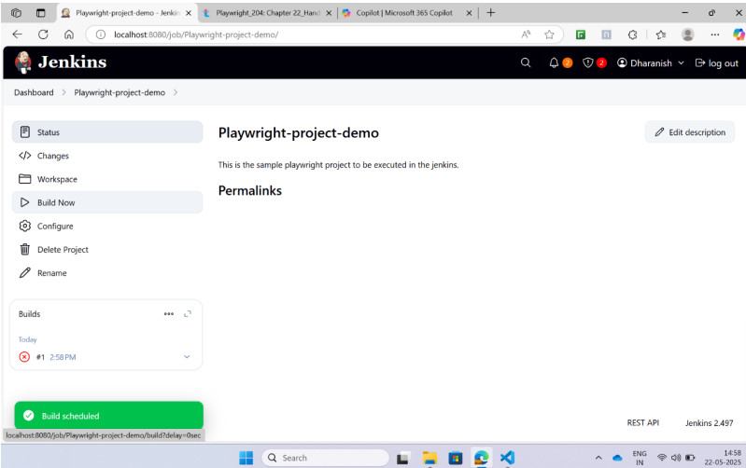
8. Build the Project by Clicking “Build Now” Option
To run your Playwright tests, click the “Build Now” link on the left-hand side of the project dashboard. Jenkins will start a new build, and you’ll see a build number appear under the Build History section. This indicates that Jenkins is executing the steps you configured, including cloning the repository and running the test scripts. In the Dashboard, select our project and click on ‘Build now’ and also click the ‘HTML report’ to visualize the report.

Slide 20
9. Verify the Logs and Build Status by Clicking “Console Output” Link
After the build starts, click on the build number (e.g., #1) under Build History, then click “Console Output”. This page displays real-time logs of the build process. You can monitor the installation of dependencies, browser setup, and test execution. If the tests pass, you’ll see a success message; if they fail, the logs will show error messages and stack traces to help you debug the issue.
View the console to view the output.

Slide 21
Jenkins Pipeline Script Example
Groovy script with:
- Install dependencies
- Run Playwright tests
- Generate Allure report
- Post-build: Publish results

Slide 22
Summary
- HTML & Allure: Better visibility
- Jenkins: CI/CD automation
- Plugins & config: Key to success

